Slide 1
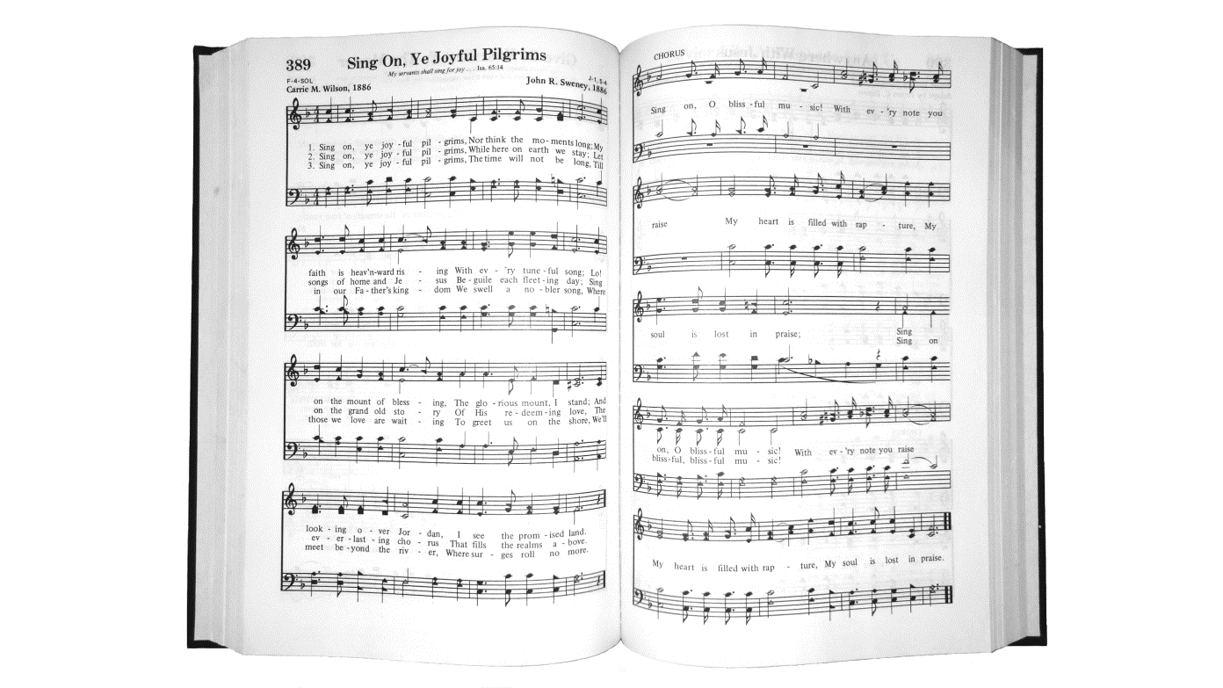
“ speaking to one another in psalms and hymns and spiritual songs…”
Ephesians 5:19
Notes:
One area where the Lord’s church differs from almost all other religious groups is musical worship.
It is rather common in discussions with those in the denominations for them to ask, Why don’t you believe in music in worship? (We do, BTW). But they mean the use of instruments, either instead of, or to accompany the singing that is done.
I would like to answer that question, to the best of my ability, in this lesson.
It is interesting that there are many who bemoan the sad state of music in the denominations today
They talk about the rise of praise bands, that leave congregants as more audience than participants
When congregants are encouraged to participate, often the lyrics are put on a screen, and only the melody is sung.
I don’t know how many times that visitors have talked about how much they enjoy the four part harmony of our a capella singing in worship.
But, that is irrelevant as to whether a capella singing, or singing with instruments is God’s way? And so, we seek to come to some determination with this lesson.
(1 Peter 3:15), “But sanctify the Lord God in your hearts, and always be ready to give a defense to everyone who asks you a reason for the hope that is in you, with meekness and fear.”
(Jude 3), “Beloved, while I was very diligent to write to you concerning our common salvation, I found it necessary to write to you exhorting you to contend earnestly for the faith which was once for all delivered to the saints.”
It might not matter to some people, who do not have a proper understanding of what the Lordship of Jesus entails.
However, we must remember the significance of Paul’s words
(Colossians 3:17), “And whatever you do in word or deed, do all in the name of the Lord Jesus, giving thanks to God the Father through Him.”

Slide 2
Question:
What is the NT pattern for music in Christian Worship?
Matthew 26:30; Mark 14:26; Acts 16:25
Romans 15:9; 1 Corinthians 14:15; Ephesians 5:18-19
Colossians 3:16; Hebrews 2:12; James 5:13
Notes:
Note: The first two verses relate to a time before the New Covenant was ratified by Christ’s blood, and in effect. But, it shows the practice of Jesus and His disciples.
Both verses refer to the night of Jesus’ betrayal, before He went with His disciples to the Garden of Gethsemene
(Matthew 26:30), “And when they had sung a hymn, they went out to the Mount of Olives.”
(Mark 14:26), “And when they had sung a hymn, they went out to the Mount of Olives.”
Acts 16 refers to Paul and Silas’ imprisonment in Philippi
(Acts 16:25), “But at midnight Paul and Silas were praying and singing hymns to God, and the prisoners were listening to them.”
The remainder of the scriptures consist of instructions the Holy Spirit gives us regarding musical worship
(Romans 15:8-9), [Not a direct reference to Christian duty] “Now I say that Jesus Christ has become a servant to the circumcision for the truth of God, to confirm the promises made to the fathers, ⁹ and that the Gentiles might glorify God for His mercy, as it is written: “For this reason I will confess to You among the Gentiles, and sing to Your name.”
Note: This a reference to Psalm 18:49.
Paul’s intent here was to show that the Gentiles were to be included among those who obtain mercy in Christ
(1 Corinthians 14:15), “What is the conclusion then? I will pray with the spirit, and I will also pray with the understanding. I will sing with the spirit, and I will also sing with the understanding.”
(Ephesians 5:18-19), “And do not be drunk with wine, in which is dissipation; but be filled with the Spirit, ¹⁹ speaking to one another in psalms and hymns and spiritual songs, singing and making melody in your heart to the Lord”
(Colossians 3:16), “Let the word of Christ dwell in you richly in all wisdom, teaching and admonishing one another in psalms and hymns and spiritual songs, singing with grace in your hearts to the Lord.”
(Hebrews 2:11-12), [Not a direct reference to Christian duty], “For both He who sanctifies and those who are being sanctified are all of one, for which reason He is not ashamed to call them brethren, ¹² saying: ‘I will declare Your name to My brethren; in the midst of the assembly I will sing praise to You.’”
Reference to the Messianic Psalm 22:22
Intent – That the Christ would sing of God the deliverer to the congregation (the saved).
(James 5:13), “Is anyone among you suffering? Let him pray. Is anyone cheerful? Let him sing psalms.”
Note: This is the sum total of the pattern given in scripture for musical worship to God.
You will notice that in every case Christians sang.
There is no mention in our English translations of the scriptures of any musical instruments being used in worship to God.
If these translations are accurate, the pattern is established. Christians are to sing, and only sing.

Slide 3
Question:
Are the English translations accurate?
humneō - 1) to sing the praise of, sing hymns to
2) to sing a hymn, to sing (Thayer)
Notes:
Are the English translations accurate?
There are three Greek terms that are translated by the English verb “sing” in the New Testament
The first term we examine is the word humneō
The term is found in four of our passages:
Matthew 26:30 and Mark 14:26, where it is translated “sung a hymn” (referring to Jesus and His disciples)
Acts 16:25 where Paul and Silas were “singing hymns”
Hebrews 2:12 where it is translated “sing praise”
The term is defined by Thayer:
1) to sing the praise of, sing hymns to 2) to sing a hymn, to sing
There is nothing in the etymology of the word, nor in the way it was used in the Greek New Testament that refers in any way to anything other than singing.
It is correctly translated “sing” in the New Testament

Slide 4
Question:
Are the English translations accurate?
adō - to the praise of anyone, to sing (Thayer)
Notes:
The second term we examine is the word adō
The term is found in two of our passages:
Ephesians 5:19 and Colossians 3:16 where it is translated by the English word “singing”
The term is defined by Thayer:
1) to the praise of anyone, to sing
Again, there is nothing in the etymology of the word, nor in the way it was used in the Greek New Testament that refers in any way to anything other than singing.
It is correctly translated “sing” in the New Testament

Slide 5
Question:
Are the English translations accurate?
psallō - 1) to pluck off, pull out
2) to cause to vibrate by touching, to twang; 2d) in the NT to sing a hymn, to celebrate the praises of God in song (Thayer)
Notes:
The final term we examine is the one that is a source of contention. It is the word psallō
The term is found in four of our passages:
Romans 15:9 where it is translated “sing”
1 Corinthians 14:15 (twice) where it is translated both times “I will sing”
James 5:13 where it is translated “let him sing Psalms”
Ephesians 5:19 where it is translated “making melody”
This is the term that those who seek scriptural authority for the use of instruments in worship use in making their appeal
The term is defined by Thayer:
1) to pluck off, pull out; 2) to cause to vibrate by touching, to twang; 2d) in the NT to sing a hymn, to celebrate the praises of God in song (Thayer)
You will notice we skipped 2a, 2b, 2c. For two reasons. 1) space on the slide. 2) Notice Thayer’s words in 2d) IN THE NT to sing a hymn
This is important, as Thayer is arguing that during NT times, the term “psallō” was defined as singing, not playing an instrument
What are the other definitions of the term?
2a) to touch or strike the chord, to twang the strings of a musical instrument so that they gently vibrate
2b) to play on a stringed instrument, to play, the harp, etc.
2c) to sing to the music of the harp
M.C. Kurfee’s, in his book Instrumental Music in the Worship does a good job of documenting the usage of the term psallō from its origin until NT times
To understand why this term is translated as it is in the NT, you must have an awareness of how the usage of words may change over time
We have many examples of this in the English language
Ex: resent 1) Original meaning indicated kindly feelings for favors receive; 2) Present meaning indicates displeasure for wrongs received.
Ex: animosity 1) Original meaning indicated spirit or courage; 2) Present meaning indicates violent hatred
Ex: prevent 1) Original meaning “to go before, precede”; 2) Present meaning “to intercept, to hinder, to stop”
In all these cases, while you may see the thread of gradual change, and can see why the definition got from there to here, in order to be properly understood you must use the term as it is defined now, not how it was defined in the past!
How is this born out in the term “psallō”?
Original meaning: to touch (with no reference at all to the object touched)
As time progressed, it was used in various ways, changing as time passed
To pluck the hair or beard
To twang the bowstring on a bow
To twitch a carpenter’s line
To touch the chords of a musical instrument
And finally, to touch the chords of the human heart, that is, to sing, to celebrate with hymns of praise (page. 16)
The period of time between 450 B.C. to 30 B.C. was a time of great changes in the Greek language, due to Macedonian and Roman influences
In order to know what any word means, it is required that you know what it meant at the time it was used or written!
We have already read Thayer’s contention that in the New Testament, the term meant to sing a hymn, to celebrate the praises of God in song
To this, we will add one more well respected authority…
Again, there is nothing in the etymology of the word, nor in the way it was used in the Greek New Testament that refers in any way to anything other than singing.
It is correctly translated “sing” in the New Testament
The Pattern Studied
Psallo is employed in Romans 15:9 ("sing"), 1 Corinthians 14:15 ("I will sing . . . I will sing"), Ephesians 5:19 ("making melody") and James 5:13 ("let him sing praise"). This word means in the N. T. to sing a hymn, to celebrate the praises of God in song (Thayer, p. 675, so Vine, III, 58). Another lesson refutes the contention this term authorizes instrumental music in worship.
The English word "psalms" is a transliteration of the Greek psalmos. The apostle employed this term in Ephesians 5:19 and Colossians 3:16. Thayer defines it thus: a striking, twanging . . . spec. a striking the chords of a musical instrument . . .; hence a pious song (p. 675).
Does this word imply the use of an instrument? According to the New Testament, psalms were spoken (Lk. 20:42, 43) and written (Lk. 24:44). Must one employ a piano or organ to speak or write? Of their use in the worship of the New Testament church, the Spirit commands, "speaking to yourselves in psalms" (Eph. 5:19). They are to be spoken, not played. Their purpose is "teaching and admonishing" (Col. 3:16). What teaching is done by the guitar's twang? What admonishing is done by the cymbal's crash? Undoubtedly, in the Old Testament pattern of worship psalms were sung to the accompaniment of instrumental music. But in the music of the New Testament church, psalms are to be rendered "with grace in your hearts" not "with a fiddle under your chin."
The term "hymns" (Eph. 5:19; Col. 3:16) transliterates the Greek humnos and "denotes a song of praise addressed to God" (Vine, II, 241).
"Spiritual songs" (ode pneumatikos; Eph. 5:19; Col. 3:16) are songs of which the burden is the things revealed by the Spirit (Vine, IV, 65), i.e., songs which teach biblical concepts.

Slide 6
Conclusion on psallō:
M.C. Kurfees
“At this time, it not only meant to sing, but that is the only sense in which it was used, all the other meanings having entirely disappeared.”
Notes:
Evangelinus Sophocles
Professor at Harvard in the mid 1800’s
Well respected Lexicographer (His lexicon is recognized as a preeminent authority)
Examined 146 secular and 77 ecclesiastical authors of the Roman period, as well as hundreds of authors, both secular and ecclesiastical as time has progressed
He declared in his lexicon throughout this long period there is not a single example of psallo involving or implying the use of an instrument!
It meant always and everywhere “to chant, sing religious hymns.”
Inescapable conclusion is stated well by M.C. Kurfees, on pages 44 and 45 of his book
“so the Greek word psallō once meant to pluck the hair, twang the bowstring, twitch a carpenter’s line, and to touch the chords of a musical instrument, but had entirely lost all of these meanings before the beginning of the New Testament period, and that, therefore, the word is never used in the New Testament nor in contemporaneous literature in any of these senses. At this time, it not only meant to sing, but that is the only sense in which it was used, all the other meanings having entirely disappeared.”
Again, there is nothing in the etymology of the word, nor in the way it was used in the Greek New Testament that refers in any way to anything other than singing.
It is correctly translated “sing” in the New Testament

Slide 7
Those who use instrumental music
Are not walking by Faith
2 Corinthians 5:7; Romans 10:17
Reject the Basis for Unity
1 Corinthians 1:10; 1 Peter 4:11
Make void their worship to God
John 4:24; Matthew 15:9
Notes:
There are several scriptural rationales we can use to show why instrumental music in worship to God is unjustifiable and sinful.
Those Who Use Instrumental Music:
Are not walking by faith.
(2 Corinthians 5:7), “For we walk by faith, not by sight.”
Context: Our hope, as revealed in scripture
Application: Our walk (what we do day by day) is based on faith, which comes from hearing God’s word, (cf. Romans 10:17).
It is because of this walk of faith that we have hope!
We can sing by faith (Ephesians 5:19; Colossians 3:16), but we cannot play instruments in worship by faith
Reject the basis for unity.
(1 Corinthians 1:10), “Now I plead with you, brethren, by the name of our Lord Jesus Christ, that you all speak the same thing, and that there be no divisions among you, but that you be perfectly joined together in the same mind and in the same judgment.”
Over 150 years ago, a great division took place among God’s people, because some did not limit themselves to the worship revealed in God’s word
To “speak the same thing” is unity of doctrine.” This is not possible unless there is a single standard upon which we agree
(1 Peter 4:11a), “If anyone speaks, let him speak as the oracles of God…”
No one can speak as the oracles of God and advocate for instrumental music in worship
Make void their worship to God
(John 4:24), “God is Spirit, and those who worship Him must worship in spirit and truth.”
Jesus, in his prayer to the Father, declared, “Your word is truth.” (John 17:17)
Since instrumental music is not found in the New Testament scriptures it is willful worship, and vain
(Mathew 15:9), [Scribes and Pharisees, who transgress God’s law because of their tradition], “Hypocrites! Well did Isaiah prophesy about you, saying: ⁸ ‘These people draw near to Me with their mouth, And honor Me with their lips, But their heart is far from Me. ⁹ And in vain they worship Me, Teaching as doctrines the commandments of men.’”
Note: These 6 points on this slide and the next are based on an article by Weldon Warnock
Guardian of Truth XXXII: 21, pp. 641, 662-663
November 3, 1988

Slide 8
Those who use instrumental music
Operate on the Silence of the Scriptures
Hebrews 7:14; Mark 7:13
Ignore the Authority of Christ
Colossians 3:17; Matthew 28:18
Go Beyond That Which is Written
1 Corinthians 4:6; 2 John 9-11
Notes:
Those who use instruments of Music:
Operate on the silence of the Scriptures. (Classically, “It doesn’t say you can’t!)
That kind of warped thinking would allow sprinkling for baptism; soda pop and bacon for the Lord’s Table; and any other thing not expressly condemned.
The writer of Hebrews clearly expresses the approach we should take to the silence of scripture
(Hebrews 7:12-14), “For the priesthood being changed, of necessity there is also a change of the law. ¹³ For He of whom these things are spoken belongs to another tribe, from which no man has officiated at the altar. ¹⁴ For it is evident that our Lord arose from Judah, of which tribe Moses spoke nothing concerning priesthood.”
As Christians, we must always seek authorization from God, and never presume upon the silence of scripture.
To presume upon the silence of scripture is to elevate one’s own desires and traditions, Just like the scribes and Pharisees.
(Mark 7:13), [Jesus accused them of], “making the word of God of no effect through your tradition which you have handed down. And many such things you do.”
Ignore the authority of Christ.
(Colossians 3:17), “And whatever you do in word or deed, do all in the name of the Lord Jesus, giving thanks to God the Father through Him.”
You can’t run back to King David for authority, King Jesus is where we place our trust and allegiance
(Matthew 28:18), “And Jesus came and spoke to them, saying, “All authority has been given to Me in heaven and on earth.”
Go beyond that which Is written.
Paul understood this important principle
(1 Corinthians 4:6), “Now these things, brethren, I have figuratively transferred to myself and Apollos for your sakes, that you may learn in us not to think beyond what is written, that none of you may be puffed up on behalf of one against the other.”
God omitted nothing he wanted us to know and do.
We are regulated by that which is written.
There is nothing written about instrumental music in worship, therefore, we go beyond the boundary of the inspired precepts when we use it.
(2 John 9-11), “Whoever transgresses and does not abide in the doctrine of Christ does not have God. He who abides in the doctrine of Christ has both the Father and the Son. ¹⁰ If anyone comes to you and does not bring this doctrine, do not receive him into your house nor greet him; ¹¹ for he who greets him shares in his evil deeds.”

Slide 9
God cares, and reveals, how He wants us to worship Him.
May we have the resolve to stand upon His revealed will!
Notes:
The issue of worship in music is a scriptural issue
Our opposition to the use of instruments is not a matter of tradition or preference
It is based in scriptural principles that are clear and unassailable
We can no more give up our opposition to the instrument than we can give up our position on baptism!
There is no place for compromise, and we must resolve to stand upon God’s word.
God has revealed His desire that we worship Him by offering up the fruit of our lips in song. Teaching and admonishing one another with Psalms, Hymns and Spiritual Songs.
It is what God wants, it satisfies Him. As such, it should satisfy us as well.

